Slide 1



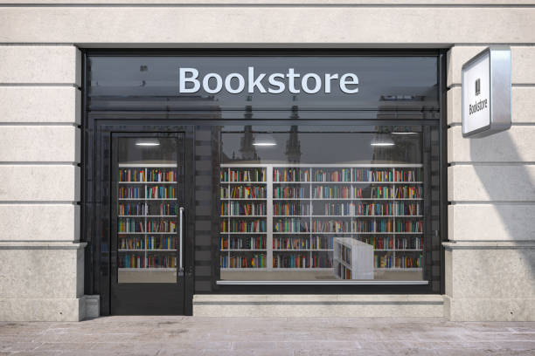
Second-Hand Book Store

Slide 2
Introduction
This project is like an Online bookstore website where books can be bought from the comfort of home through the Internet. An Online Second-Hand Book Store is a virtual store on the Internet where customers can browse the catalogue and select books of interest. User can select many books and those books stored in cart. At checkout time, the items in the shopping cart will be presented as an order. At that time, more information will be needed to complete the transaction. Usually, the customer will be asked to fill the basic details or select a billing address, a shipping address, a shipping option, and payment information such as credit card number.

Slide 3
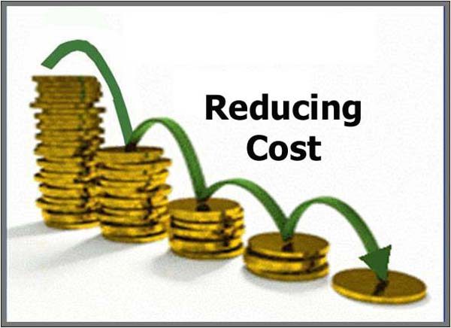

Scope of Work
Online Book Store carries out the traditional selling process in an electronic form, using the internet. The object of the present invention is to provide an electronic reselling system that reduces the amount of money spent, and at the same time, that identifies the real users who need the book and have offered the contract price, and moreover, to gain revenue to the Original Bookseller.
Online stores are usually available 24 hours a day, and many consumers have Internet access both at work and at home.
Searching or browsing an online catalog can be faster than browsing the physical store.

Slide 4
Modules
User
Admin
Registration
Login
View Books
Buy Books
Upload Books
Delete Books
My Orders
Cancel Order
Payment
View Buyer
My Cart
Update Profile
Change Password
Login
View Books
View Orders
View User

Slide 5
Functionalities
User
Registration: User need to register first with their basic registration details and nee to create a valid login id and password.
Login: Using valid login credentials, user need to login into the system in order to access the system.
View Books: Once user is logged into the, he/she may view all the added/uploaded books with their details.
Buy Books: User can surf various book of their choice and buy them.
Upload Books: System allows user to sell their books online buy added the book name and its details.
Delete Uploaded Book : User can delete uploaded book by giving specific reasons.

Slide 6
8. Payment : User can do payment for their orders.
9. View Buyer: If any buyer is interested in buying a book or anyone buys a book from the user then buyer’s details will be displayed.
10. Cancel Order : User can cancel their orders.
11. Update Profile : User can update their profile.
12. My Cart : User can add book to his cart.
13. Change Password : User can change their account password.
14. My Orders: All the purchase history of user will be displayed with details.

Slide 7
Admin
Login: Using valid login credentials, admin need to login into the system in order to access the system.
View Books: Admin can view all the added books online with their details.
View Orders: System allows admin to view all the orders details of buying and selling a book.
View User: All the registered user details will be displayed to the admin

Slide 8


Objectives of System
The major goal for Online Second-Hand Book Store that in future people, especially students should have an easy way to buy and sell secondhand books online. The user can earn more money using selling his secondhand books. The users will be able to carry out all these in a secured and managed environment. The second-hand Book store shall be easy to navigate and user friendly and easy to find books in various categories. It shall be easy to administer and handling of orders and sales processes shall be easy to handle by the administrator.

Slide 9
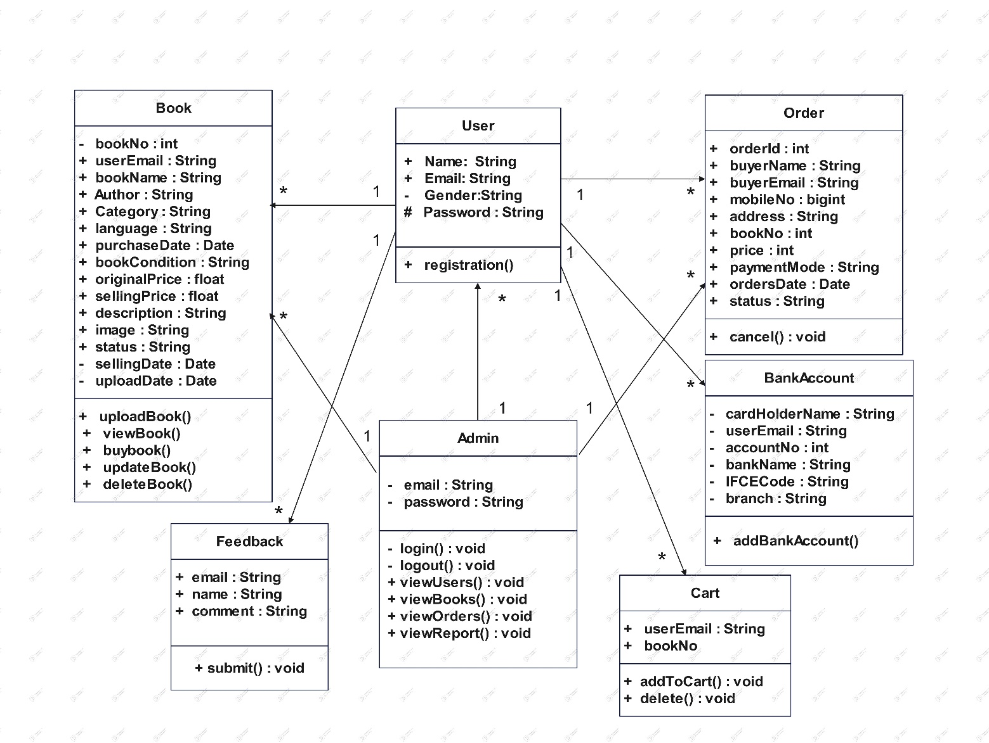
ANALYSIS & DESIGN
Class Diagram

Slide 10
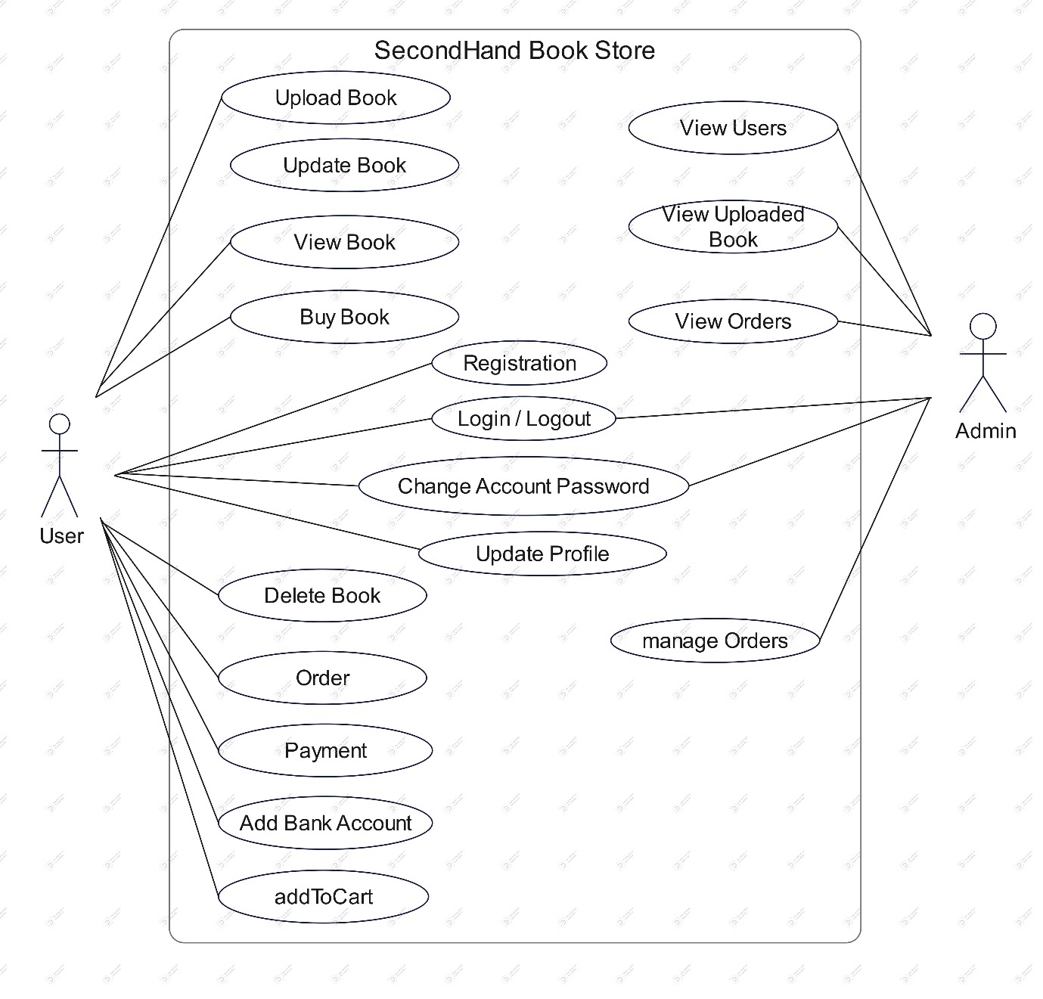
Use Case diagram

Slide 11
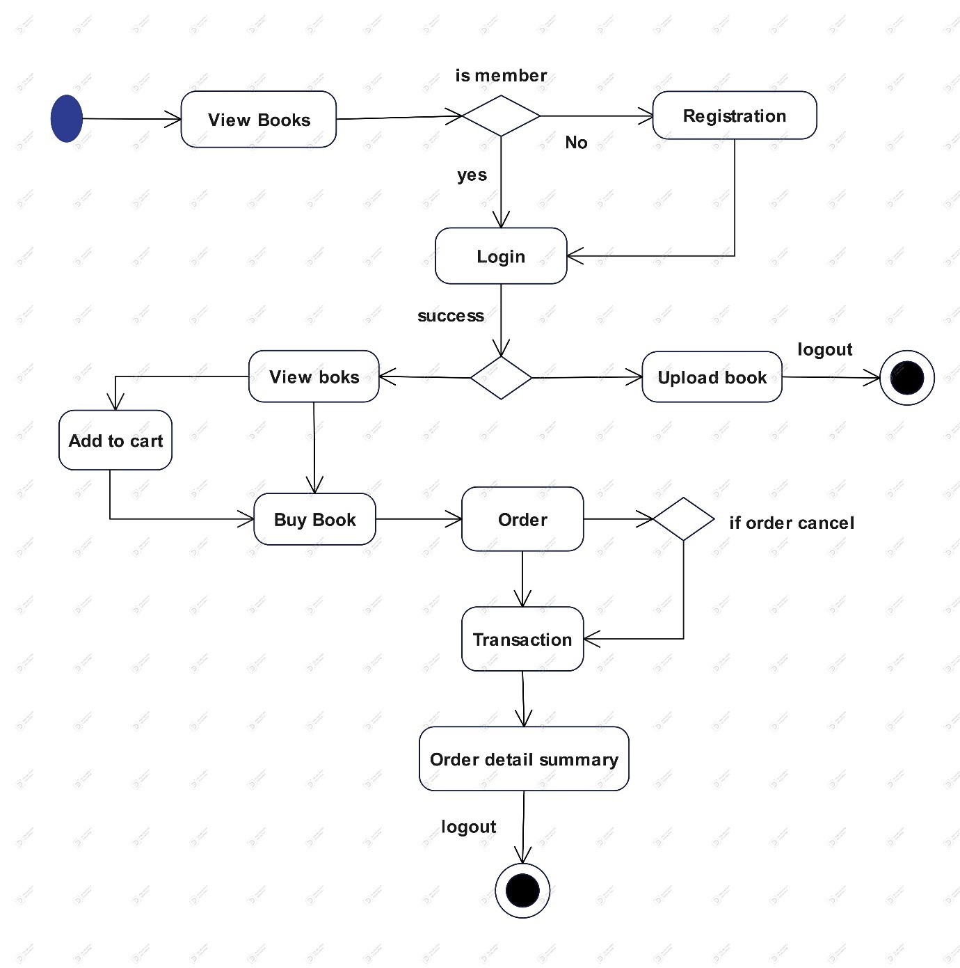
Activity diagram

Slide 12
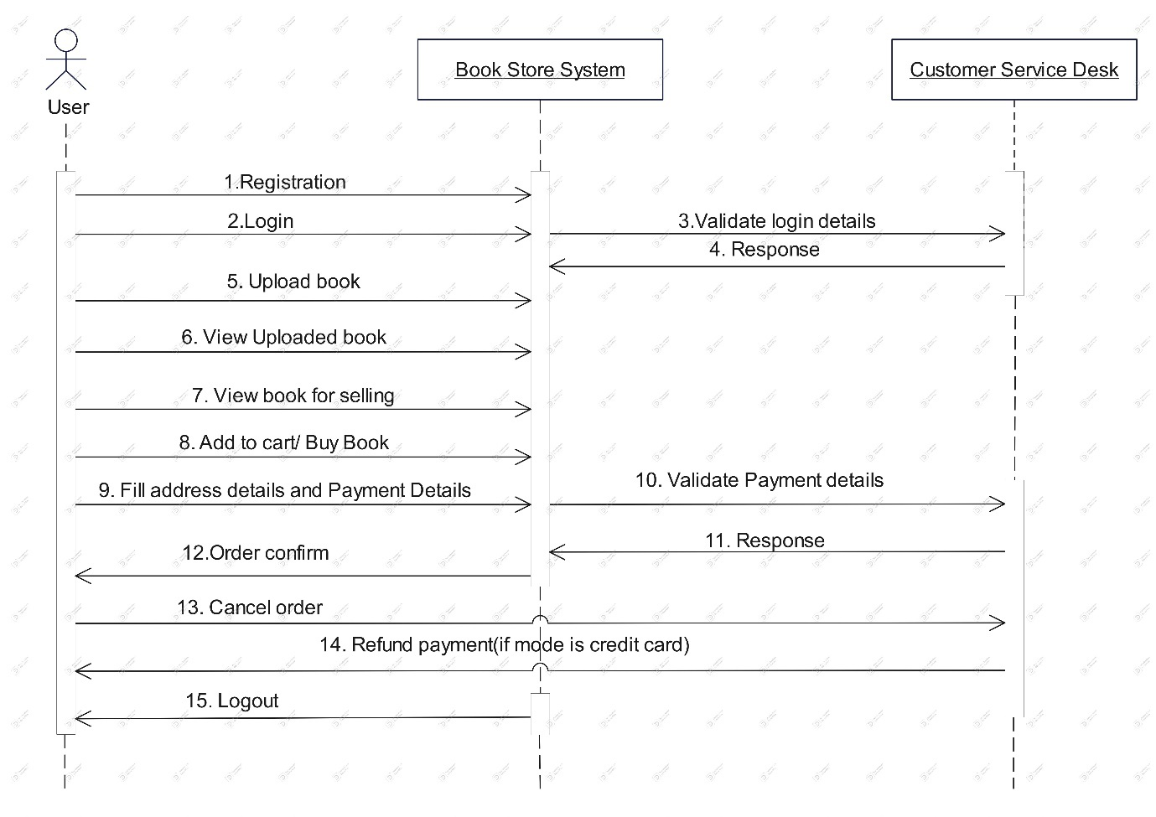
Sequence Diagram

Slide 13
Table specifications
Table Name : Admin
Column Name | Data Type | Constraint
Srno | Int (11) | Primary Key
Email | varchar (50) | Not Null
Password | varchar (8) | Not Null
Table Name : User
Column Name | Data Type | Constraint
Name | Varchar (30) | NOT NULL
Email | Varchar (50) | Primary Key
Gender | Varchar (8) | NOT NULL
Contact No | Varchar (10) | NOT NULL
City | Varchar (20) | NOT NULL
Password | Varchar (8) | NOT NULL
Answer | Varchar (20) | NOT NULL

Slide 14
Table Name : Books
Column Name | Data Type | Constraint
Bno | Int (11) | Primary Key
User | Varchar (50) | Foreign Key
Book Name | Varchar (50) | NOT NULL
Author Name | Varchar (30) | NOT NULL
Category | Varchar (20) | NOT NULL
Book Language | Varchar (8) | NOT NULL
Purchase date | date | NOT NULL
Book Condition | Varchar (5) | NOT NULL
Original Price | float | NOT NULL
Selling Price | float | NOT NULL
Description | Varchar (50) | NOT NULL
Image | Varchar (30) | NOT NULL
Status | Varchar (15) | NOT NULL
Selling date | date | NOT NULL
Upload date | date | NOT NULL

Slide 15
Table Name : Orders
Column Name | Data Type | Constraint
Order No | Int (11) | Primary Key
Order ID | Varchar (12) | NOT NULL
Buyer Name | Varchar (30) | NOT NULL
Buyer Email | Varchar (50) | NOT NULL
Mobile No | Varchar (10) | NOT NULL
Address | text | NOT NULL
Book No | Int (11) | Foreign Key
Price | float | NOT NULL
Payment Mode | Varchar (20) | NOT NULL
Selling date | date | NOT NULL
Status | Varchar (20) | NOT NULL

Slide 16
Table Name : Bank Accounts
Column | Data Type | Constraint
Srno | Int (11)1 | Primary Key
Name | Varchar (30) | NOT NULL
Email | Varchar (50) | Foreign Key
Account No | Varchar (20) | NOT NULL
Bank Name | Varchar (50) | NOT NULL
IFCE Code | Varchar (15) | NOT NULL
Branch | Varchar (30) | NOT NULL

Slide 17
Table Name : Cart
Column Name | Data Type | Constraint
Cno | Int (11) | Primary Key
User | Varchar (50) | Foreign Key
Book No | Int(11) | Foreign Key
Table Name : Feedbacks
Column Name | Data Type | Constraint
Srno | Int (11) | Primary Key
Email | Varchar (50) | Foreign Key
Name | Varchar (30) | NOT NULL
Comment | text | NOT NULL

Slide 18
Bibliography
Reference Books:
1. JAVA SERVLET PROGRAMMING
-By Jason Hunter
2. JAVA 2 (Black Book)
-By Steven Holzner et al.
3. UML 2.0
-By Dan Pilone
Websites :
https://www.geeksforgeeks.org/
https://www.javatpoint.com/
https://getbootstrap.com/

Slide 19


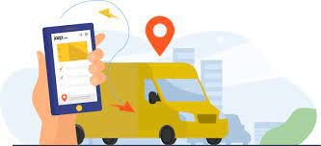


Limitations
User cannot return a book once he has bought
Admin cannot delete users.
user cannot track his orders.

Slide 20
Thank You

